Slide 1
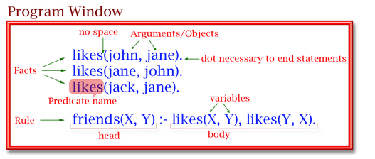
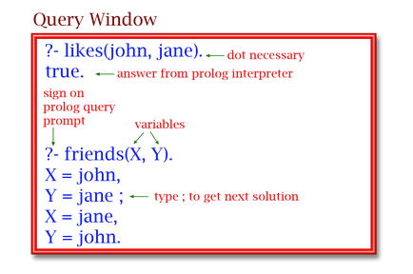

Slide 2
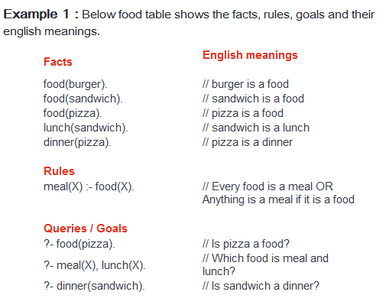

Slide 3
From Example 1 : (1) ?- meal(X), dinner(X). (2) ?- meal(What). (3) ?- meal(X), dinner(Y).

Slide 4
